Slide 1
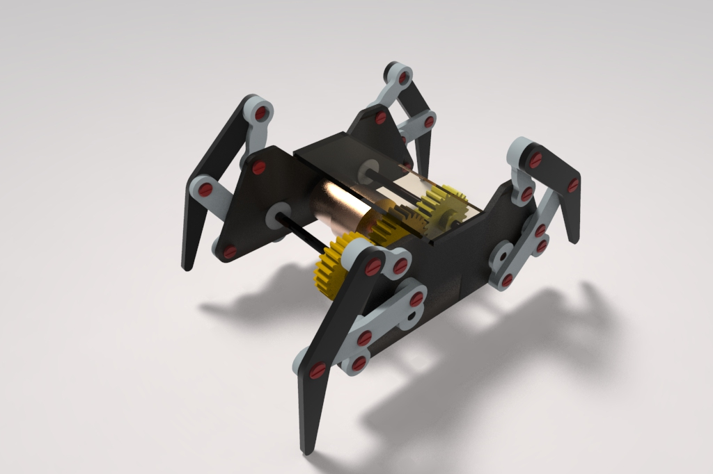
Design of a Mechanical Crab
Group Members:
Ashish Rao
Basavesh Y
Sindhoor Hegde
Darshan Bhat

Slide 2
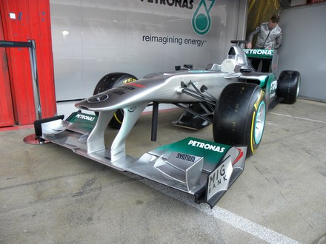
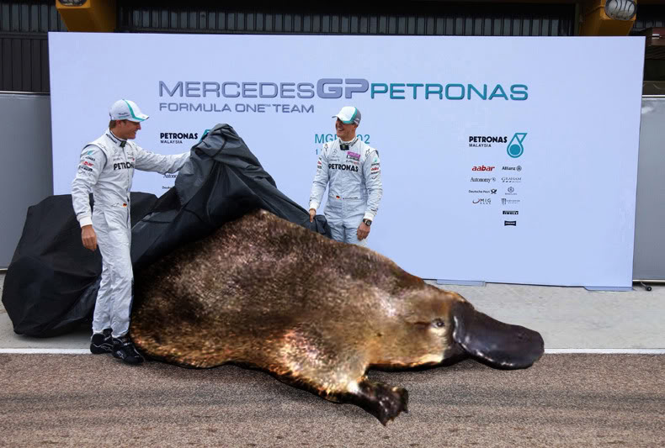
WHY?

Slide 3
Objective
Design and develop an alternative to wheel based locomotive systems.

Slide 4
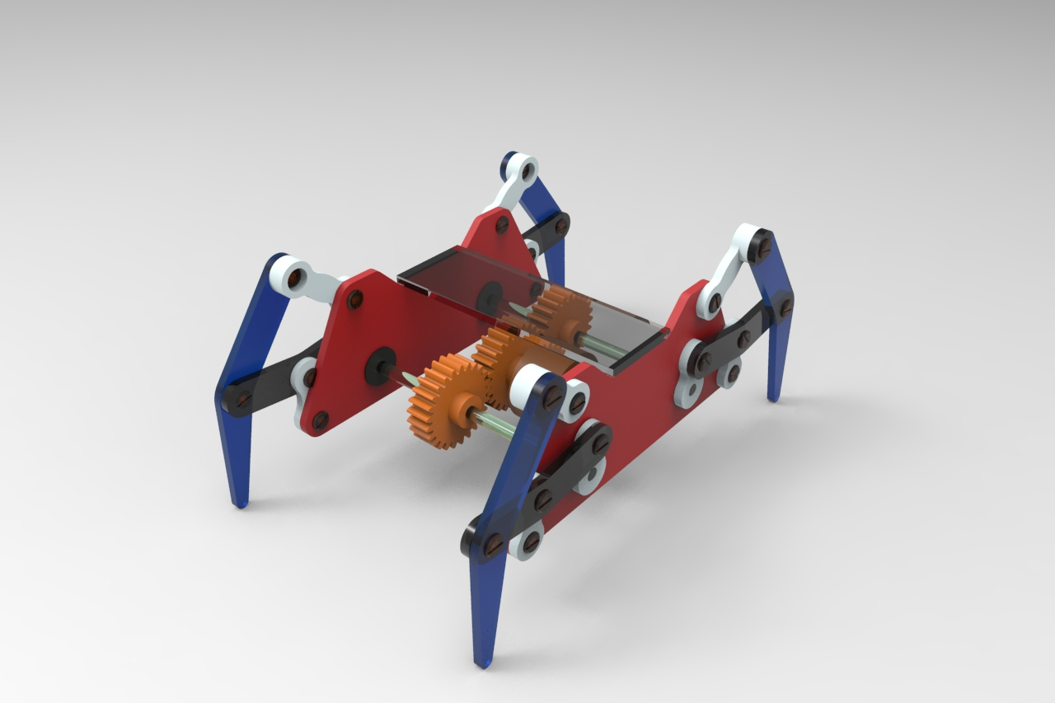
Goal
To build a four legged Mechanical Crab using Klann Mechanism
Klann Linkages:
The Klann linkage is a planar mechanism designed to simulate the gait of legged animal and function as a wheel replacement.
The linkage consists of the frame, a crank, two rocker arms, and two couplers all connected by pivot joints.
It can climb stairs, walking on the wavy surface where wheels become quite inefficient.
It does not require microprocessor control or multitudes of actuator mechanisms

Slide 5
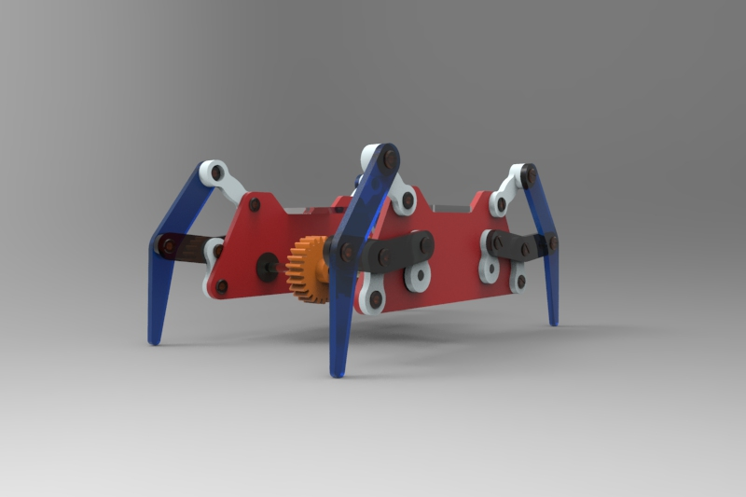
Concept Design
Can be assembled in the manner shown
Material to be used is Aluminum /Pine wood/
Acrylic

Slide 6
Project Stages
Literature Survey
Understanding Mechanisms
Design of Klann Linkages
Material Selection
Material Purchase
CAD Modeling of Crab
Design of Drive Systems
Final Assembly
Fabrication of Crab parts
Assembly

Slide 7
Klann’s Enable Diagram
Required to design Linkages for specified stride length
There are six inputs for the enable Diagram:
Input 1 52p - 50s
Input 2 Rad 53c
Input 3 Angle 9
Input 4 Angle 65p
Input 5 74p - 75p
Input 6 27x - 29x

Slide 8
Enable Diagram for 50 mm Stride
The crab is designed for a stride length of 50 mm.
The six inputs take values based on the stride length as 1 unit.

Slide 9
Design of Linkages
The length of the linkages for obtained for the maximum stride Klann Diagram

Slide 10
Design
Force Diagram
Velocity Diagrams
Pin Design
Shaft Design
Motor Selection
Gear Design

Slide 11
Static Force Diagram

Slide 12
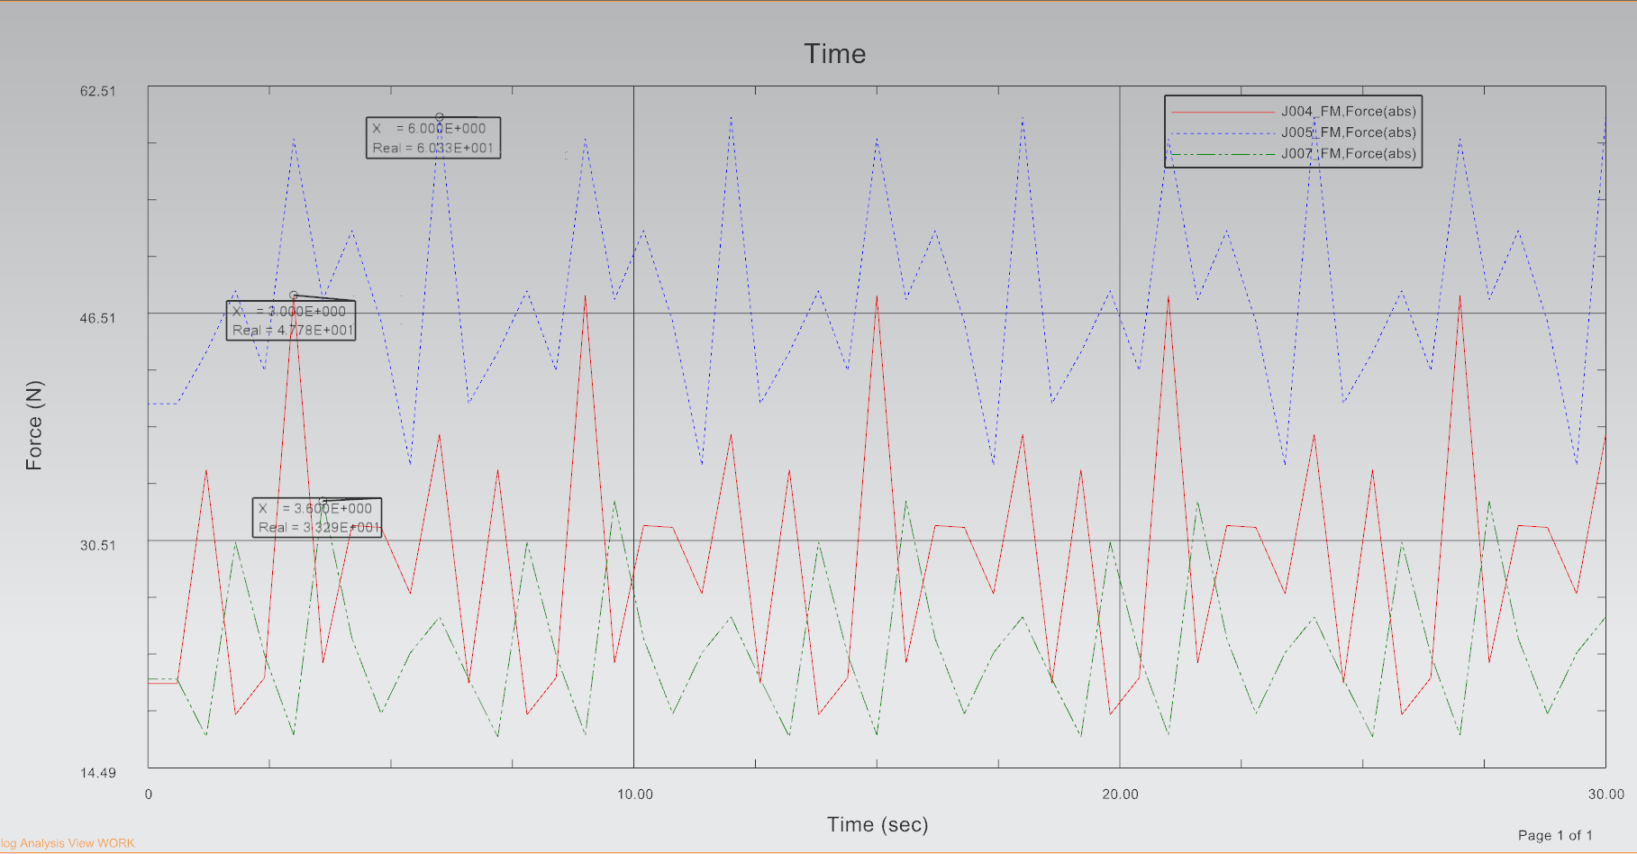

Slide 13
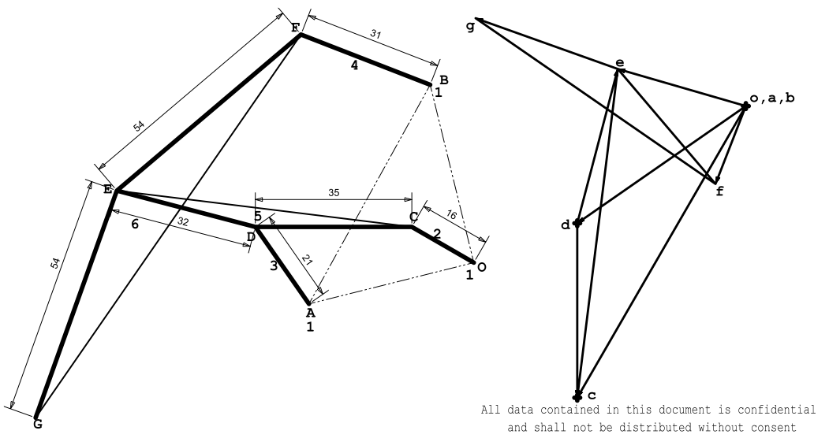
Velocity Diagram

Slide 14
Pin Design
Max Force F53=50.3 N
For Brass, 𝛔y=135 MPa
𝜏y=135/2=67.5 MPa
For n=2, 𝜏max=𝜏y/n=33.75 MPa
𝜏max =F/A=50.3/A
𝝅𝑑²/4=50.3/33.75
∴𝑑=1.3775 mm
We choose 𝑑 of 4.2mm due to market availability

Slide 15
Shaft Design

Slide 16
Motor Selection
It can be calculated from the design that a torque is required to drive the system 0.33 N-m
A 12 W, 12 V motor rated at 30 rpm is selected which satisfies the torque (0.485 N-m) requirement.

Slide 17
Gear Design
Assumptions:
teeth is 20 degrees involute full depth
Tp=25
Material ABS, 𝛔y=44MPA
With FOS =1.5, allowable stress 𝛔a=44/1.5=29.33 MPa
Pitch line velocity 𝛎=(𝛑*𝑚*Tp*N)/60
for N=30 RPM 𝛎=0.0392𝑚 m/s
Service factor Cs=1, and 𝜂mot =0.8 , Tangential tooth load Ft=P*Cs/𝛎= 290.81/𝑚

Slide 18
Gear Design
Velocity factor Cv=(3/3+v) for v less than 6 m/s
for pinion tooth form factor y=0.1175 for 25 teeth
From Lewis equation, Ft=𝛔a*Cv*b*𝑚*y*𝝅
we have b=10*𝑚 which gives 𝑚=1.3
Gears of module 1.5 are readily available which are incorporated in the final model
Therefore b= 1.5*𝑚=15 mm

Slide 19
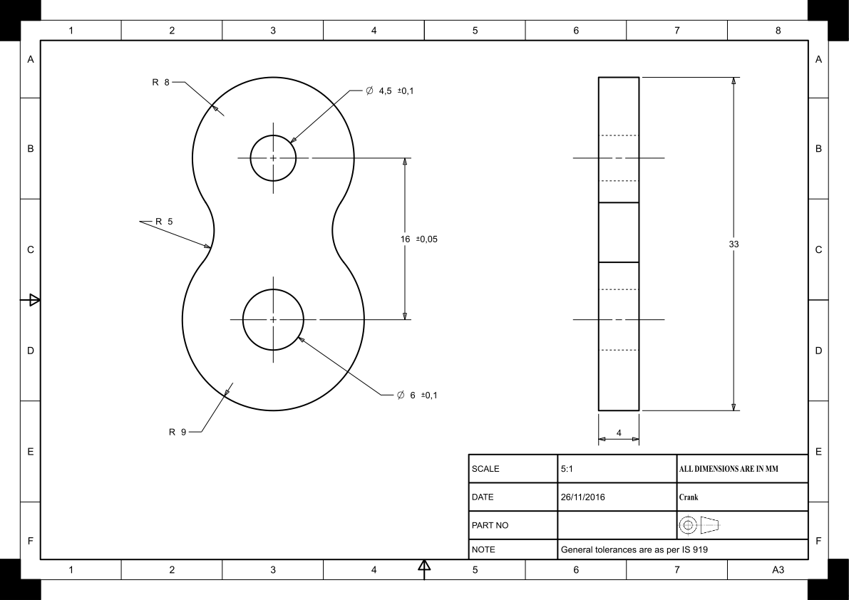
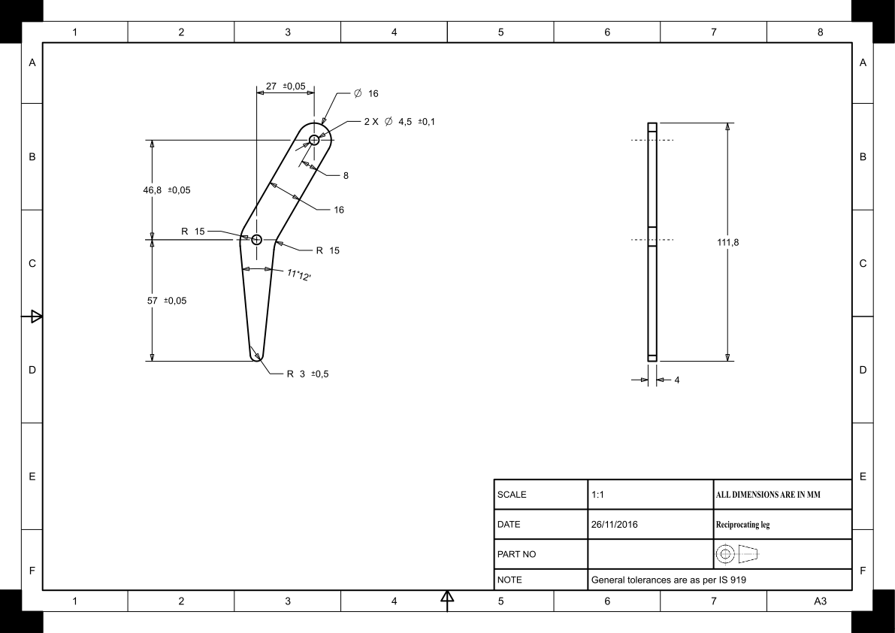
Part Drawings:
Crank and Reciprocating leg

Slide 20
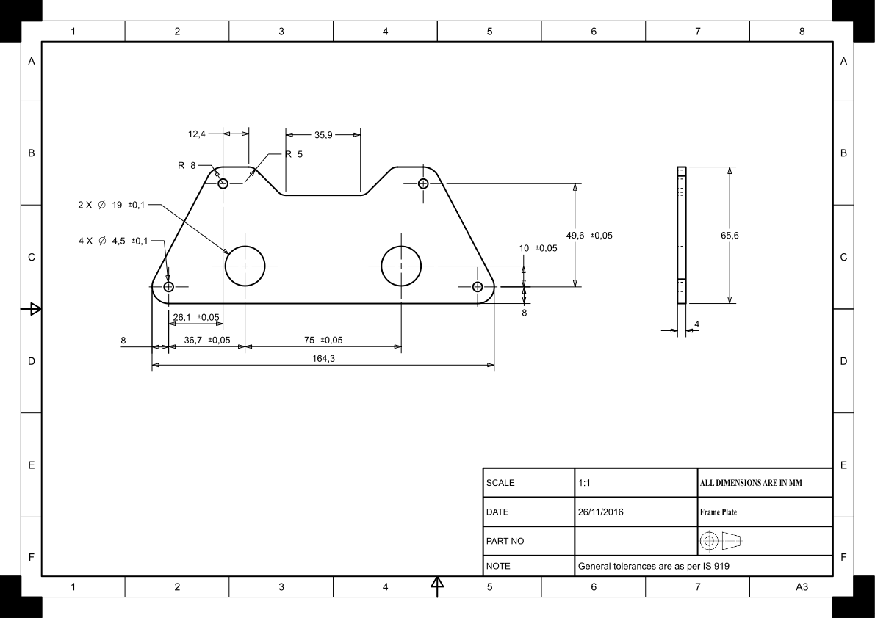
Part Drawings:
Frame and Connecting Arm

Slide 21
Part Drawings:
Upper and Lower Rocker Arms

Slide 22
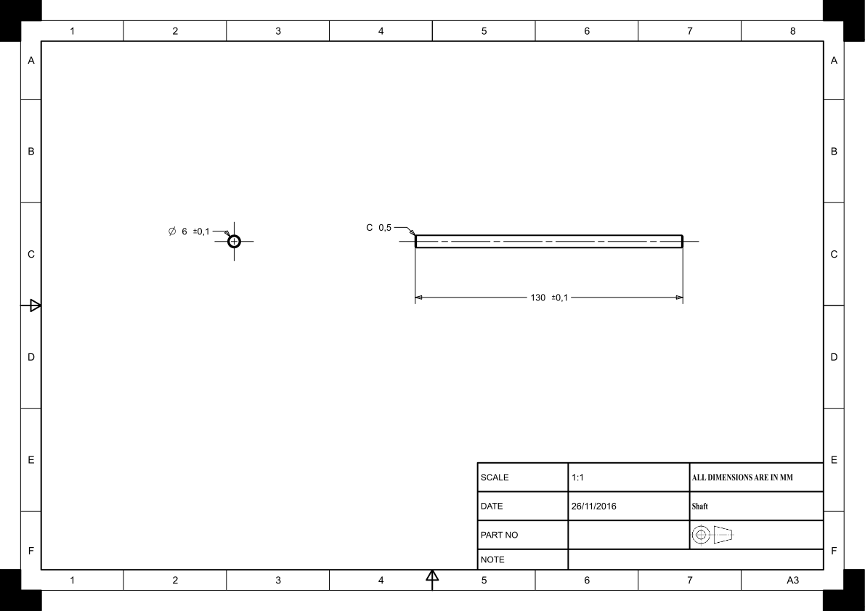
Part Drawings:
Connecting Plates and Shaft

Slide 23
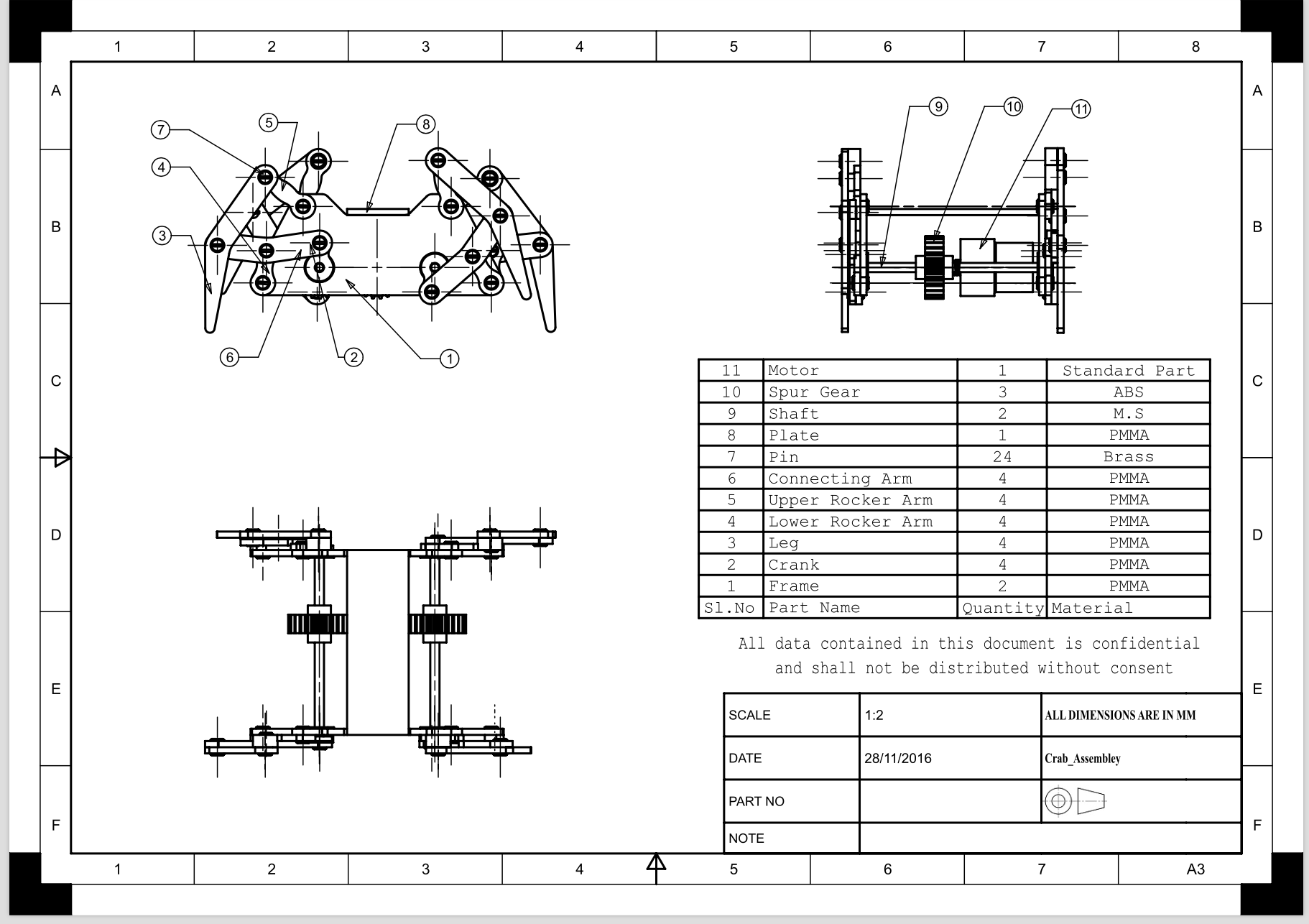
Assembly Drawing

Slide 24
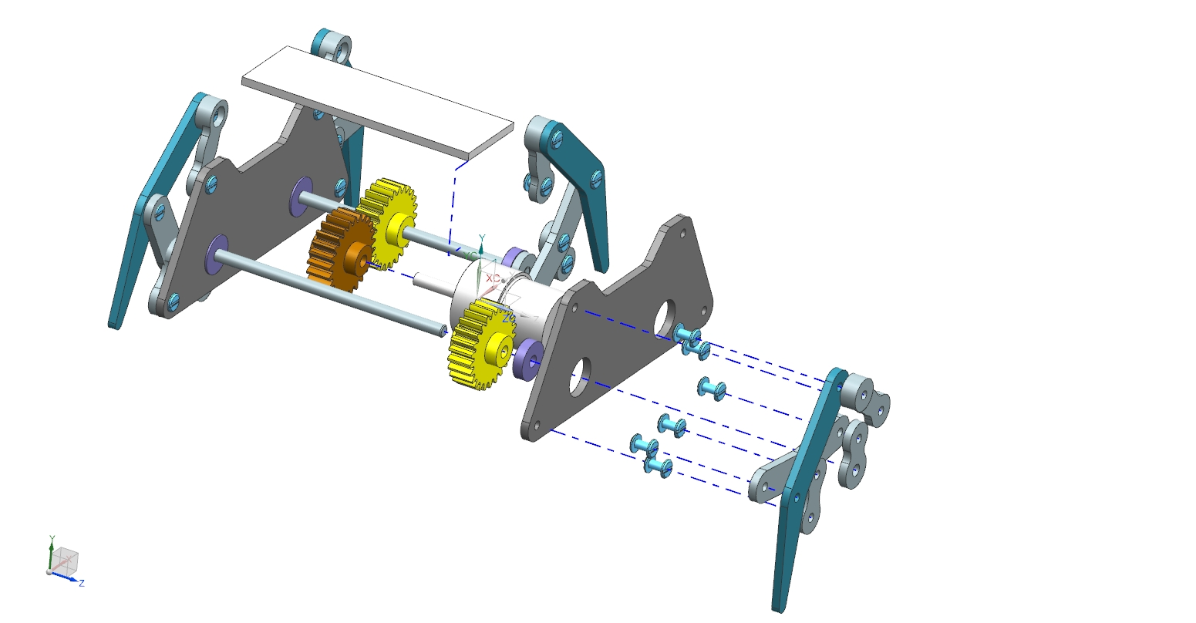

Slide 25
The Trajectory of the Reciprocating Leg

Slide 26
Challenges and Solutions
Loosening of barrel screw due to vibration
Solution:
1. Lock Nut can be used to decrease this effect
2. Usage of Teflon tape as a temporary fill-in
Interference between links/ barrel screw head & link
Solution:
Change in design must not affect the prior function of crab. In our case, interference between barrel screw head and frame, is solved by reducing the length of shaft.
Dynamic stability of crab -major challenge -can minimized with equal distribution of weight
High Traction required to climb taller obstacles

Slide 27
For the next prototypes…
Multidirectional movement
Self sustainable energy integration
Increase legs to provide static stability

Slide 28
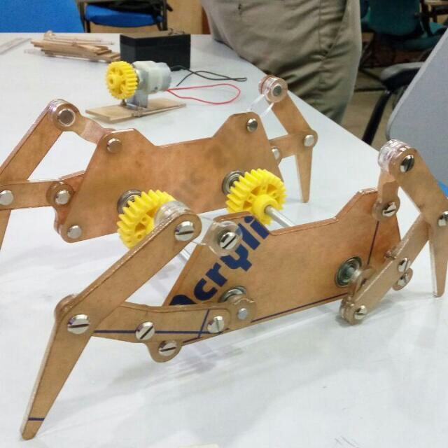
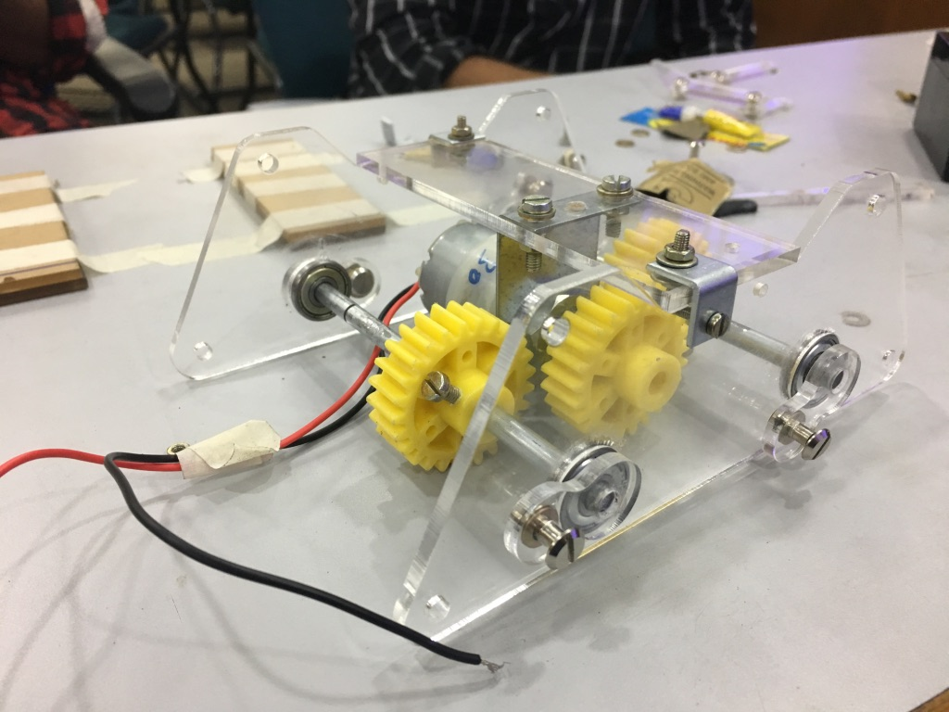
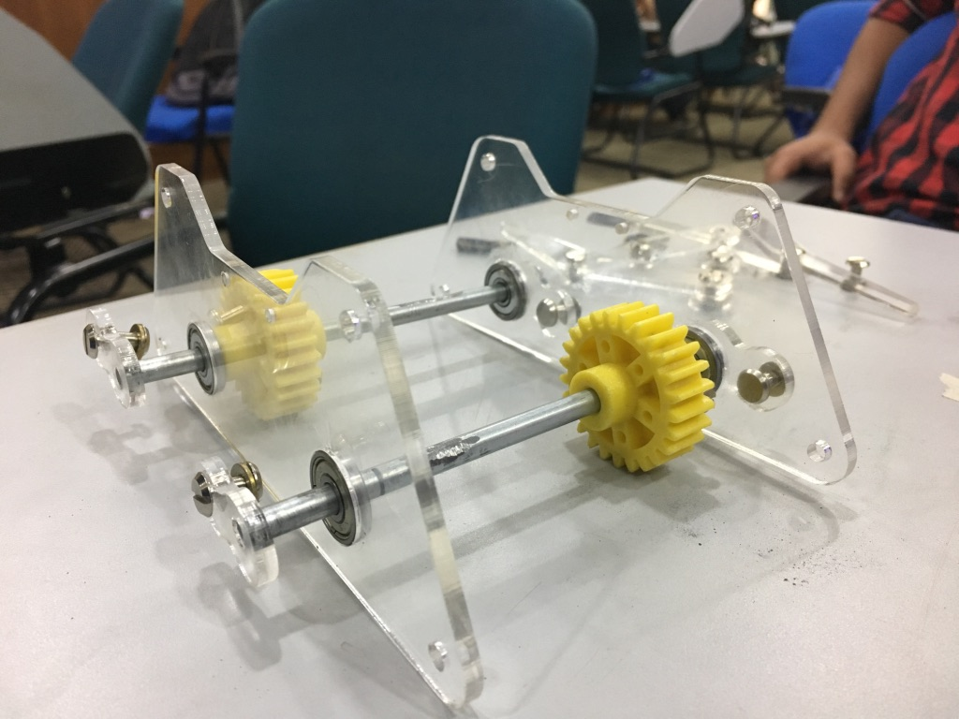
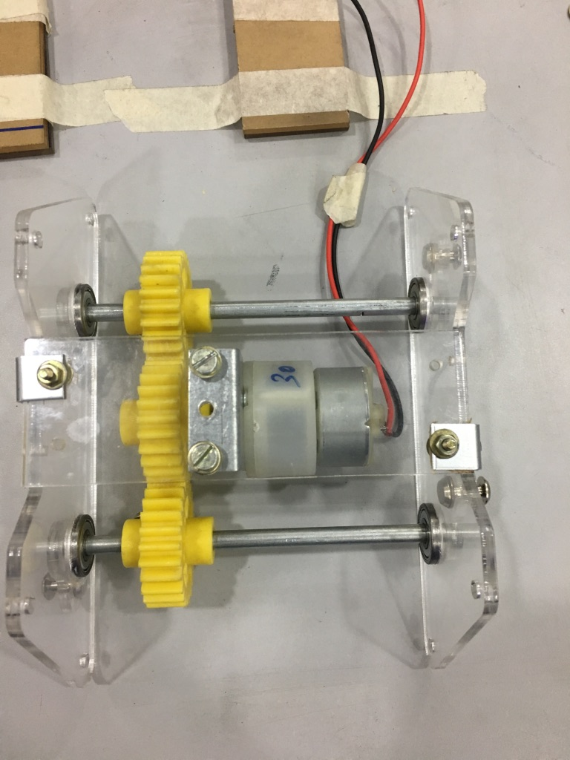
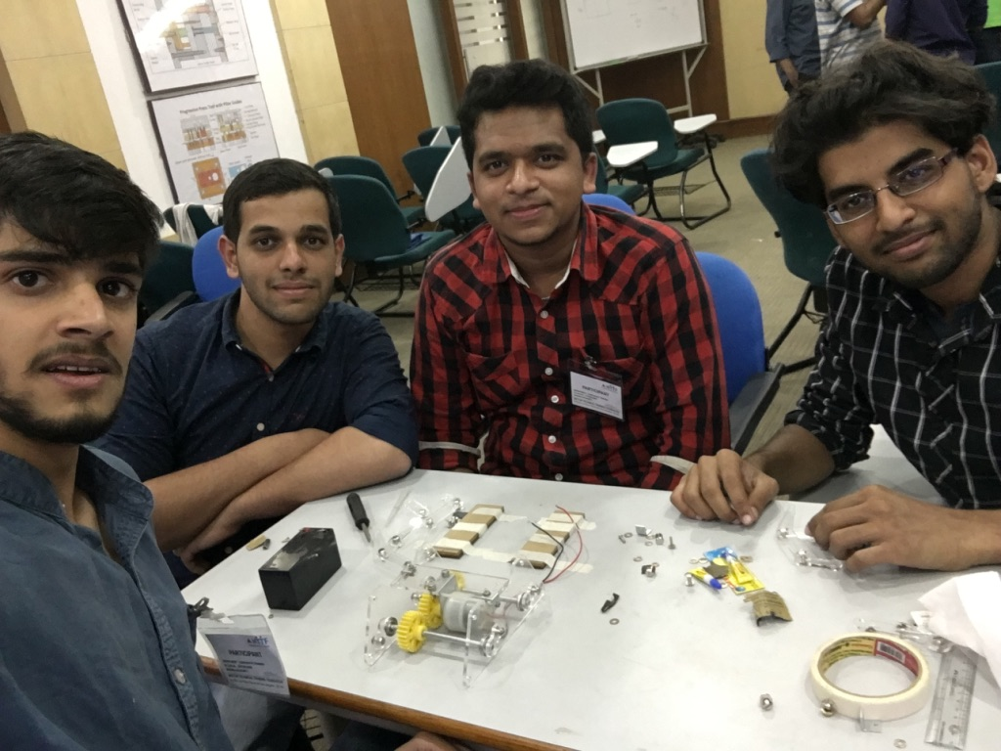
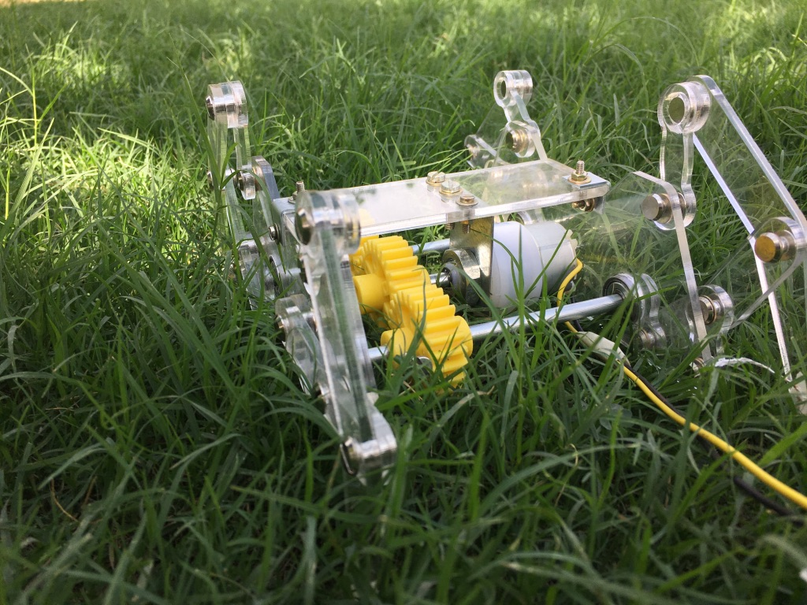
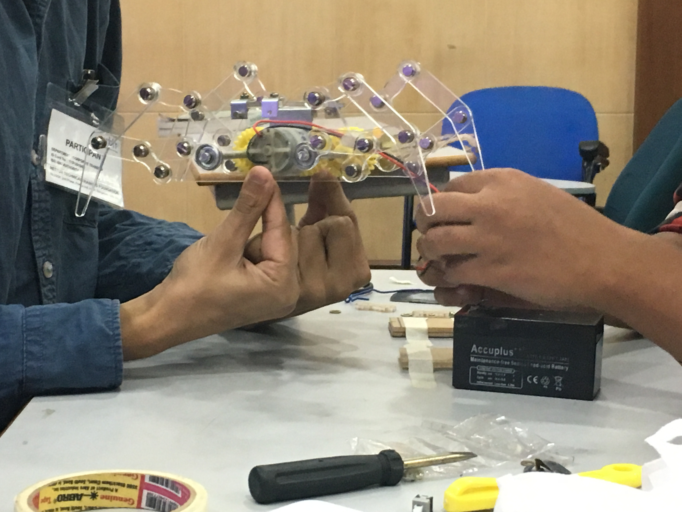

Slide 29
THANK YOU

